Slide 1
Goals and Accomplishments of CYVYC State Team Experiences
Valerie Bradley
Human Services Research Institute CYVYC Advisory Committee June 18, 2025

Slide 2

State Team Goals
Create SDM agreements
Collect data on numbers of guardianships by county judicial district
Canvass local courts to ensure SDM is offered as an alternative
Introduce SDM during transition from school to adulthood
Produce information sheets on health decisions for parents and children
Create an SDM advisory committee
Review Individualized Education Plan templates to determine whether SDM is explored
Tie SDM to person centered planning expectations
Provide guides to families on how to use SDM
Educate the judiciary on alternatives to guardianship

Slide 3

State Team Accomplishments
Expanded understanding and implementation of state law
Drafting a pro se package for people with IDD subject to guardianship
Changing transition policies to include self-direction
Getting SDM into new IPP template
Securing grant to work with doctors in training re: SDM
Creating and disseminating resources on SDM
Collecting county by county data on guardianships
Working on SDM legislation

Slide 4
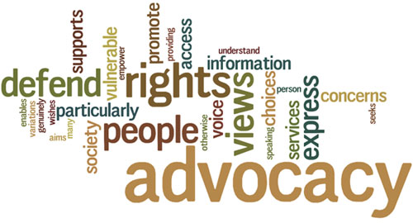
Continuation of Youth Ambassadors
Continue to do presentations and support YAs
Continue to reach out to the judicial system
Apply for additional grant funding
Include YAs in DD Council state plan
Complete the pro se package that people with disabilities can use to defend themselves in guardianship proceedings
Collaborate on a series of issue briefs on guardianship in the state

Slide 5

Lessons Learned
Team members were grateful that they had the opportunity to work with Youth Ambassadors
Members were impressed with the creativity of the YAs and their commitment to social justice
Members learned a lot about how to support youth
Virtually all members said they would continue to work with youth in the future

Slide 6
Thank you
Brita Tamm
502-555-0152
brita@firstupconsultants.com
www.firstupconsultants.com

